Slide 1

Crosswalk from Cancer Registry to OMOP Oncology Module
Rimma Belenkaya

Slide 2
Outline
ETL of Diagnoses
ETL of Diagnostic Modifiers
Value as concept
Value as number
Derivation of disease Episodes
First occurrence

Slide 3
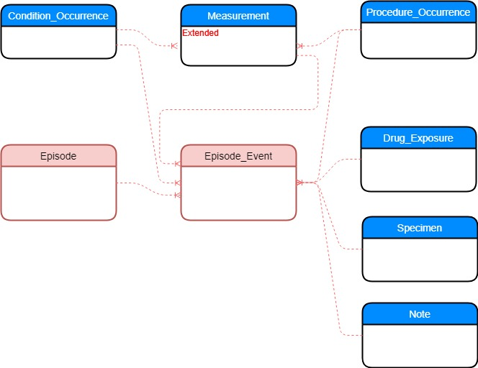
Oncology Model in OMOP CDM
Diagnosis,
pre-coordinated concept representing histology and topography
Modifier representing diagnostic and treatment features
Underlying events
Disease and Treatment
Episodes
Connection between
Episode and
Underlying events

Slide 4
Cancer Registry Patient Record Sample
Field# | NAACCR Item # | NAACCR Item Name | NAACCR Value | Value Description
1 | 20 | Patient ID Number | 123456
2 | 400 | Primary Site | C50.9 | Breast, NOS
3 | 522 | Histologic Type ICD-O-3 | 8010/3 | Carcinoma, NOS
4 | 390 | Date of Diagnosis | Jun-9-2019
5 | 410 | Laterality | 1 | Right: origin of primary
6 | 440 | Grade | 4 | Grade IV
7 | 390 | Summary Stage 2018 | 2 | Regional by direct extension only

Slide 5
Source Table Structure
Field Name | Field Type | Required | Field Description
person_id | integer | Yes | Patient ID
record_id | varchar(100) | Yes | Unique primary tumor occurrence ID
naaccr_item_number | integer | Yes | NAACCR Item #
naaccr_item_value | varchar(100) | Yes | NAACCR item value
histology_topography | varchar(20) | Yes | Concatenated histology and topography

Slide 6
Source Data Sample
person_id | record_id | naaccr_item_number | naaccr_item_value | histology_site
1 | http://mskcc.org/tumorregistry/1_000001 | 400 | C50.9 | 8010/3-C50.9
1 | http://mskcc.org/tumorregistry/1_000001 | 522 | 8010/3 | 8010/3-C50.9
1 | http://mskcc.org/tumorregistry/1_000001 | 390 | Jun-9-2019 | 8010/3-C50.9
1 | http://mskcc.org/tumorregistry/1_000001 | 410 | 1 | 8010/3-C50.9
1 | http://mskcc.org/tumorregistry/1_000002 | 2800 | 30 | 8010/3-C50.9
1 | http://mskcc.org/tumorregistry/1_000002 | 400 | C50.9 | 8010/3-C50.9
1 | http://mskcc.org/tumorregistry/1_000002 | 522 | 8010/3 | 8010/3-C50.9
1 | http://mskcc.org/tumorregistry/1_000002 | 390 | Jun-9-2019 | 8010/3-C50.9
1 | http://mskcc.org/tumorregistry/1_000002 | 410 | 3 | 8010/3-C50.9
Map field names in your source to NAACCR item ids
Site and histology must be converted to the following format: C50.9 and 8010/3
Add histology_site field to the source data (will simplify ETL)

Slide 7
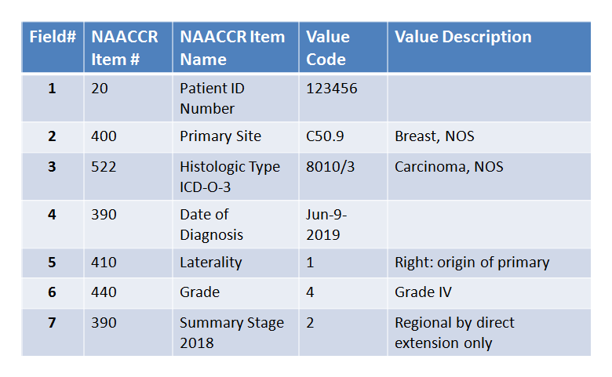
Crosswalk for Diagnosis
Cancer Registry patient record
CONDITION_OCCURRENCE record
CONCEPT: source concept for diagnosis
CONCEPT_RELATIONSHIP
CONCEPT: standard concept for diagnosis

Slide 8
SQL for ETL of Diagnosis
Insert into condition_occurrence
(condition_occurrence_id,
person_id,
condition_start_datetime,
condition_concept_id,
condition_type_concept_id,
condition_source_value,
condition_source_concept_id)
select
row_number() over() as condition_occurrence_id,
s.person_id as person_id,
to_date(s.naaccr_item_value,'MM/DD/YYYY') as condition_start_datetime,
c2.concept_id as condition_concept_id,
32534 as condition_type_concept_id, -- ‘Tumor registry’ concept
s.histology_site as condition_source_value,
c1.concept_id as condition_source_concept_id
from data_source as s
join concept as c2 on c2.standard_concept ='S'
join concept_relationship as ra on ra.concept_id_2 = c2.concept_id and ra.relationship_id = 'Maps to'
join concept as c1 on c1.concept_id = ra.concept_id_1
and c1.concept_code = s.histology_site
and c1.vocabulary_id ='ICDO3'
where s.naaccr_item_number = '390'
order by s.person_id

Slide 9
Modifier for the First Occurrence
It is temporarily added to explicitly indicate condition_occurrence record corresponding to the first occurrence extracted from Cancer Registry.
This modifier is not extracted from the data as other modifiers.

Slide 10
SQL for ETL of First Occurrence Modifier
Insert into measurement
(measurement_id,
person_id,
measurement_datetime,
measurement_concept_id,
measurement_type_concept_id,
measurement_source_value,
modifier_of_event_id,
modifier_field_concept_id)
select distinct
row_number() over() as measurement_id, fco.*
from
(select distinct
co.person_id as person_id,
co.condition_start_datetime as measurement_datetime,
32528 as measurement_concept_id, -- ‘Disease First Occurrence’ concept
32534 as measurement_type_concept_id, -- ‘Tumor registry’ concept
'First disease occurrence' as measurement_source_value,
co.condition_occurrence_id as modifier_of_event_id,
1147127 as modifier_field_concept_id -- ‘condition_occurrence.condition_occurrence_id’ concept
from data_source as s
join condition_occurrence as co on s.person_id = co.person_id
and to_date(s.naaccr_item_value,'MM/DD/YYYY') = co.condition_start_datetime
and s.naaccr_item_number = '390'
and co.condition_source_value = s.histology_site) as fco

Slide 11
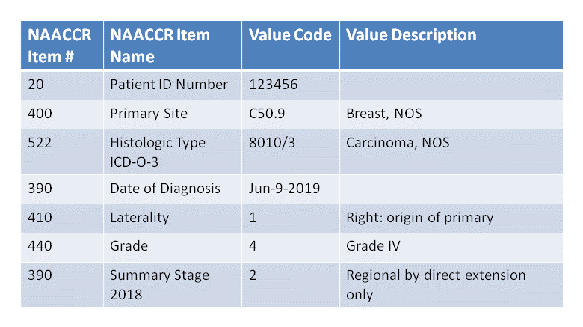
Crosswalk for Diagnostic Modifiers: value as concept
Cancer Registry patient record
CONDITION_OCCURRENCE record
CONCEPT: source concept for diagnosis
CONCEPT_RELATIONSHIP
CONCEPT_RELATIONSHIP
CONCEPT: concept for diagnostic schema
Measurement record
CONCEPT: standard concept for value
CONCEPT_RELATIONSHIP
CONCEPT_RELATIONSHIP
CONCEPT: standard concept for laterality
CONCEPT: standard concept for date

Slide 12
SQL for ETL of Diagnostic Modifier: value as concept INSERT clause
Insert into measurement
(measurement_id,
person_id,
measurement_datetime,
measurement_concept_id,
value_as_concept_id,
measurement_type_concept_id,
measurement_source_value,
measurement_source_concept_id,
value_source_value,
modifier_of_event_id,
modifier_field_concept_id)

Slide 13
SQL for ETL of Diagnostic Modifier: value as concept SELECT clause
select row_number() over() as measurement_id, cm.*
from (
select distinct
s.person_id as person_id
, to_date(sd.naaccr_item_value,'MM/DD/YYYY') as measurement_datetime
, c2.concept_id as measurement_concept_id
, c3.concept_id as value_as_concept_id
, 32534 as measurement_type_concept_id -- ‘Tumor registry’ concept
, c2.concept_code as measurement_source_value
, c2.concept_id as measurement_source_concept_id
, c3.concept_code as value_source_value
, co.condition_occurrence_id
, 1147127 as modifier_field_concept_id -- ‘condition_occurrence.condition_occurrence_id’ concept

Slide 14
SQL for ETL of Diagnostic Modifier: value as concept FROM clause
FROM data_source AS s
-- Getting schema
JOIN concept d
ON d.vocabulary_id = 'ICDO3' AND d.concept_code = s.histology_site
JOIN concept_relationship cr1
ON d.concept_id = cr1.concept_id_1 AND cr1.relationship_id = 'ICDO to Schema'
JOIN concept AS c1
ON cr1.concept_id_2 = c1.concept_id AND c1.vocabulary_id = 'NAACCR'
---- Getting variables
JOIN concept AS c2
ON c2.vocabulary_id = 'NAACCR' AND (c2.concept_code = s.naaccr_item_number OR c2.concept_code = c1.concept_code || '@' || s.naaccr_item_number)
-- Identify numeric type variables
left join concept_relationship cn
on c2.concept_id = cn.concept_id_1 and cn.relationship_id = 'Has type' and cn.concept_id_2 = 32676
---- Getting permissible value
JOIN concept AS c3
ON c3.vocabulary_id = 'NAACCR' AND (c3.concept_code = s.naaccr_item_number || '@' || s.naaccr_item_value OR c3.concept_code = c1.concept_code || '@' || s.naaccr_item_number || '@' || s.naaccr_item_value)
---- Getting date
join concept_relationship crd
on c2.concept_id = crd.concept_id_1 and crd.relationship_id = 'Variable has date'
join concept cd on crd.concept_id_2 = cd.concept_id
join data_source as sd
on s.person_id = sd.person_id and sd.naaccr_item_number = cd.concept_code
---- Getting condition_occurrence record
join
(select
co.person_id
, co.condition_occurrence_id
, s.record_id
from
(select
co.person_id
, co.condition_occurrence_id
, date(co.condition_start_datetime) as condition_start_date
, co.condition_source_value
, rank () OVER (PARTITION BY co.person_id ORDER BY co.person_id, co.condition_occurrence_id) AS occurrence_number
FROM condition_occurrence co
where co.condition_type_concept_id = 32534) as co
join
(select
s.person_id
, s.record_id
, to_date(s.naaccr_item_value,'MM/DD/YYYY') as condition_start_date
, s.histology_site
, rank () OVER (PARTITION BY s.person_id ORDER BY s.person_id, s.record_id) AS occurrence_number
FROM data_source AS s
where s.naaccr_item_number = '390'
) as s
on co.person_id = s.person_id
and co.occurrence_number = s.occurrence_number
and co.condition_source_value = s.histology_site) as co
on co.person_id = s.person_id
and co.record_id = s.record_id
where cn.concept_id_1 is null -- excluding numeric types
) as cm

Slide 15
NAACCR Numeric Items in Vocabulary
NAACCR Item #2800 ‘CS Tumor Size’
Concept
Concept Relationship
Field | Value
concept_id | 4325345
concept_name | CS Tumor Size
concept_code | June 9, 2019
vocabulary_id | NAACCR
domain_id | Measurement
Field | Value | Description
concept_id_1 | 4325345 | CS Tumor Size
concept_id_2 | 999991 | Numeric
relationship_id | has type
Field | Value | Description
concept_id_1 | 4325345 | CS Tumor Size
concept_id_2 | 999992 | mm
relationship_id | has units

Slide 16
NAACCR Numeric Items in Vocabulary
NAACCR Values
Concept
Concept_Numeric
Scenario | NAACCR Values | Description
1 | 001-988 | 001 - 988 millimeters (mm) (Exact size to nearest mm)
2 | 989 | 989 mm or larger
3 | 991 | Described as "less than 1 centimeter (cm)"
4 | 992 | Described as "less than 2 cm," or "greater than 1 cm," or "between 1 cm and 2 cm"
Field | Value | Value | Value
concept_id | 4325346 | 4325347 | 4325348
concept_name | 989 mm or larger | less than 1 cm | Between 1 and 2 cm
concept_code | 2800@989 | 2800@991 | 2800@992
vocabulary_id | NAACCR | NAACCR | NAACCR
domain_id | Meas Value | Meas Value | Meas Value
Field | Value | Value | Value | Value
concept_id | 4325346 | 4325347 | 4325348 | 4325348
concept_as_value | 989 | 1 | 1 | 2
concept_unit_id | cm | cm | cm | cm
operator_concept_id | Equal of greater | Equal of less | Equal of greater | Equal of less

Slide 17
SQL for ETL of Diagnostic Modifier: value as number INSERT clause
Insert into measurement
(measurement_id,
person_id,
measurement_datetime,
measurement_concept_id,
value_as_concept_id,
value_as_number,
unit_concept_id,
operator_concept_id,
measurement_type_concept_id,
measurement_source_value,
measurement_source_concept_id,
value_source_value,
modifier_of_event_id,
modifier_field_concept_id)

Slide 18
SQL for ETL of Diagnostic Modifier: value as number SELECT clause
select row_number() over() as measurement_id, cm.*
from (
select distinct
s.person_id as person_id
, to_date(sd.naaccr_item_value,'MM/DD/YYYY') as measurement_datetime
, c2.concept_id as measurement_concept_id
, c3.concept_id as value_as_concept_id
, case when c3.concept_id is null then cast(s.naaccr_item_value as integer) else cn.value_as_number end as value_as_number
, case when c3.concept_id is null then cru.concept_id_2 else cn.unit_concept_id end as measurement_unit_id
, case when c3.concept_id is null then null else cn.operator_concept_id end as operator_concept_id
, 32534 as measurement_type_concept_id -- ‘Tumor registry’ concept
, c2.concept_code as measurement_source_value
, c2.concept_id as measurement_source_concept_id
, c3.concept_code as value_source_value
, co.condition_occurrence_id
, 1147127 as modifier_field_concept_id -- ‘condition_occurrence.condition_occurrence_id’ concept

Slide 19
SQL for ETL of Diagnostic Modifier: value as number FROM clause
FROM data_source AS s
-- Getting schema
JOIN concept d
ON d.vocabulary_id = 'ICDO3' AND d.concept_code = s.histology_site
JOIN concept_relationship cr1
ON d.concept_id = cr1.concept_id_1 AND cr1.relationship_id = 'ICDO to Schema'
JOIN concept AS c1
ON cr1.concept_id_2 = c1.concept_id AND c1.vocabulary_id = 'NAACCR'
-- Getting variable
JOIN concept AS c2
ON c2.vocabulary_id = 'NAACCR' AND (c2.concept_code = s.naaccr_item_number OR c2.concept_code = c1.concept_code || '@' || s.naaccr_item_number)
-- Constraining to numeric concepts only
JOIN concept_relationship AS crn
on c2.concept_id = crn.concept_id_1 and crn.relationship_id = 'Has type'
and crn.concept_id_2 = 32676 -- numeric
-- Getting units if exist
left JOIN concept_relationship AS cru
on c2.concept_id = cru.concept_id_1 and cru.relationship_id = 'Has unit'
-- Getting permissible value for ranges
left JOIN concept AS c3
ON c3.vocabulary_id = 'NAACCR' AND (c3.concept_code = s.naaccr_item_number || '@' || s.naaccr_item_value OR c3.concept_code = c1.concept_code || '@' || s.naaccr_item_number || '@' || s.naaccr_item_value)
left JOIN concept_numeric AS cn
ON c3.concept_id = cn.concept_id
---- Getting date
join concept_relationship crd
on c2.concept_id = crd.concept_id_1 and crd.relationship_id = 'Variable has date'
join concept cd on crd.concept_id_2 = cd.concept_id
join data_source as sd
on s.person_id = sd.person_id and sd.naaccr_item_number = cd.concept_code
---- Getting condition_occurrence record
join
(select
co.person_id
, co.condition_occurrence_id
, s.record_id
from
(select
co.person_id
, co.condition_occurrence_id
, date(co.condition_start_datetime) as condition_start_date
, co.condition_source_value
, rank () OVER (PARTITION BY co.person_id ORDER BY co.person_id, co.condition_occurrence_id) AS occurrence_number
FROM condition_occurrence co
where co.condition_type_concept_id = 32534) as co
join
(select
s.person_id
, s.record_id
, to_date(s.naaccr_item_value,'MM/DD/YYYY') as condition_start_date
, s.histology_site
, rank () OVER (PARTITION BY s.person_id ORDER BY s.person_id, s.record_id) AS occurrence_number
FROM data_source AS s
where s.naaccr_item_number = '390'
) as s
on co.person_id = s.person_id
and co.occurrence_number = s.occurrence_number
and co.condition_source_value = s.histology_site) as co
on co.person_id = s.person_id
and co.record_id = s.record_id
) as cm

Slide 20
Derivation of First Occurrence Episode
CONDITION_OCCURRENCE record
EPISODE record
EPISODE_EVENT record

Slide 21
SQL for derivation of First Occurrence: Episode
Insert into episode
(episode_id,
person_id,
episode_start_datetime,
episode_end_datetime,
episode_concept_id,
episode_object_concept_id,
episode_type_concept_id)
select row_number() over() as episode_id
, co.person_id as person_id
, co.condition_start_datetime as episode_start_datetime
, now()
, 32528 as episode_concept_id -- ‘Disease First Occurrence’ concept
, co.condition_concept_id as episode_object_concept_id
, 32534 as episode_type_concept_id -- ‘Tumor registry’ concept
From condition_occurrence as co
join measurement as m on co.condition_occurrence_id = m.modifier_of_event_id
and m.modifier_field_concept_id = 1147127 -- condition_occurence.condition_occurrence_id
and m.measurement_concept_id = 32528 -- ‘First disease occurrence’ concept

Slide 22
SQL for derivation of First Occurrence: Episode_Event
Insert into episode_event
(episode_id,
event_id,
event_field_concept_id)
select e.episode_id as episode_id
, co.condition_occurrence_id as episode_event_id
, 1147127 as episode_event_field_concept_id -- ‘condition_occurrence.condition_occurrence_id’ concept
From condition_occurrence as co
join episode as e on e.person_id = co.person_id
and e.episode_concept_id = 32528 -- 'Disease first occurrence'
and e.episode_type_concept_id = 32534 -- 'Tumor registry'
join measurement as m on co.condition_occurrence_id = m.modifier_of_event_id
and m.modifier_field_concept_id = 1147127 -- condition_occurrence.condition_occurrence_id
and m.measurement_concept_id = 32528

Slide 23
SQL for derivation of First Occurrence modifiers INSERT clause
Insert into measurement
(measurement_id,
person_id,
measurement_datetime,
measurement_concept_id,
value_as_concept_id,
value_as_number,
unit_concept_id,
operator_concept_id,
measurement_type_concept_id,
measurement_source_value,
measurement_source_concept_id,
value_source_value,
modifier_of_event_id,
modifier_field_concept_id)

Slide 24
SQL for derivation of First Occurrence modifiers INSERT clause
select row_number() over() as measurement_id,
m.person_id,
m.measurement_datetime,
m.measurement_concept_id,
m.value_as_concept_id,
m.value_as_number,
m.unit_concept_id,
m.operator_concept_id,
m.measurement_type_concept_id,
m.measurement_source_value,
m.measurement_concept_id,
m.value_source_value,
e.episode_id ,
0 as episode_event_field_concept_id -- ‘condition_occurrence.condition_occurrence_id’ concept
From episode as e
join episode_event as ee on e.episode_id = ee.episode_id
join condition_occurrence as co on ee.event_id = co.condition_occurrence_id
and ee.event_field_concept_id = 1147127
join measurement as m on co.condition_occurrence_id = m.modifier_of_event_id
and m.modifier_field_concept_id = 1147127

